Slide 1
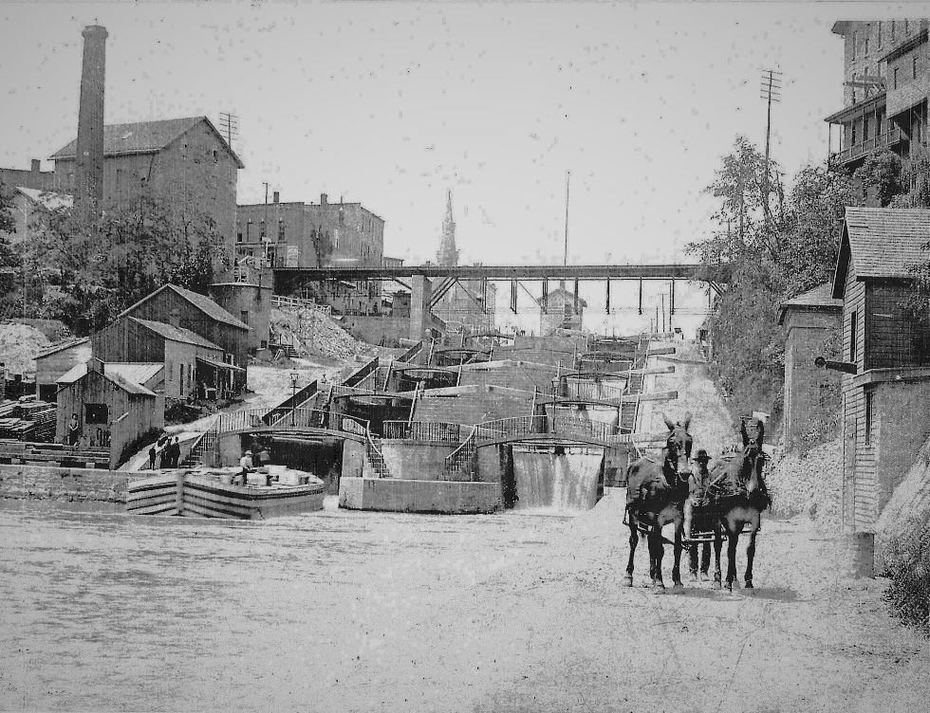
Building Locks:
Virtual Lessons
on the Erie Canal
and Lockport’s
Flight of Five

Slide 2
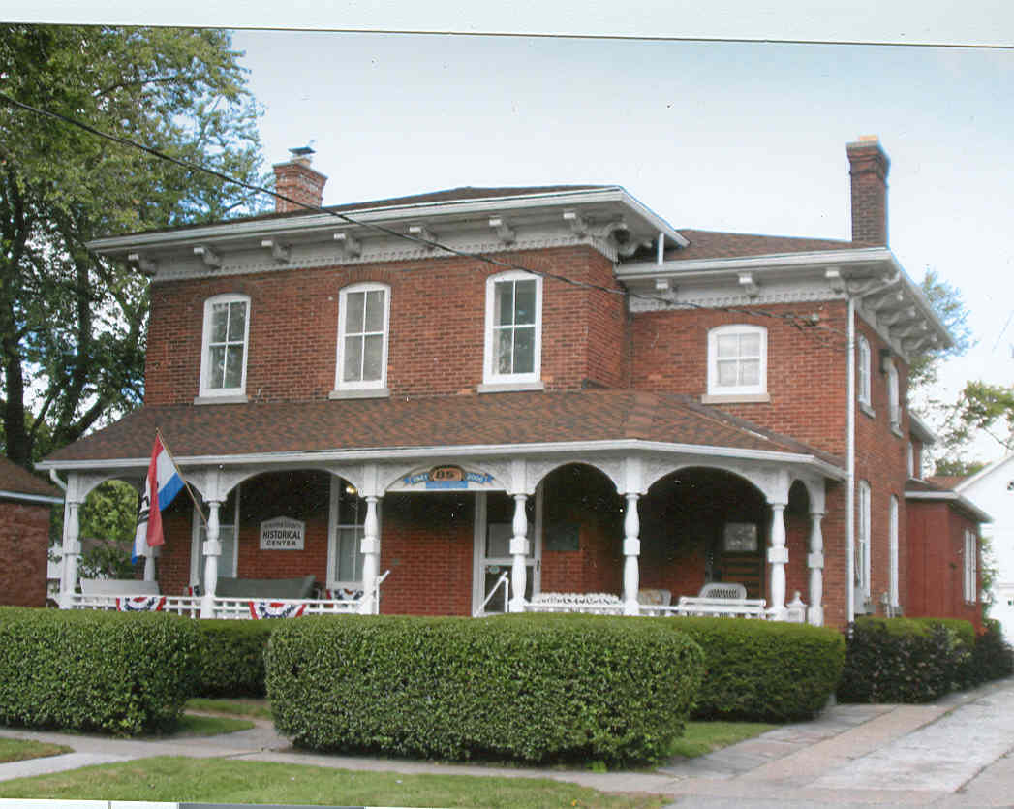
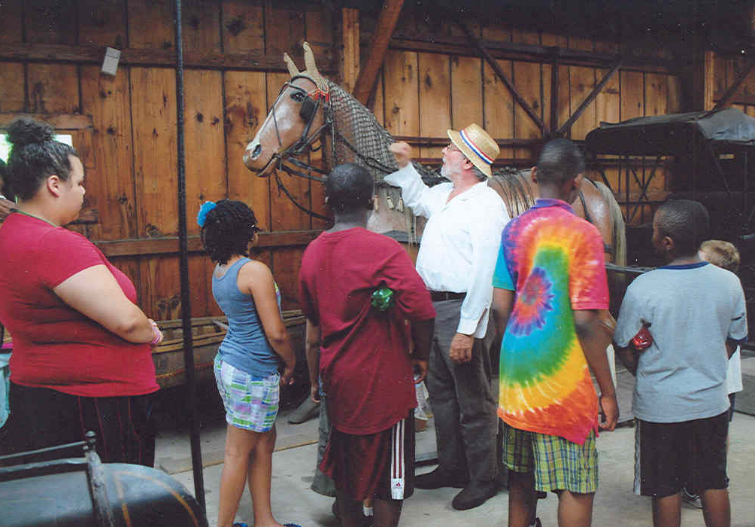
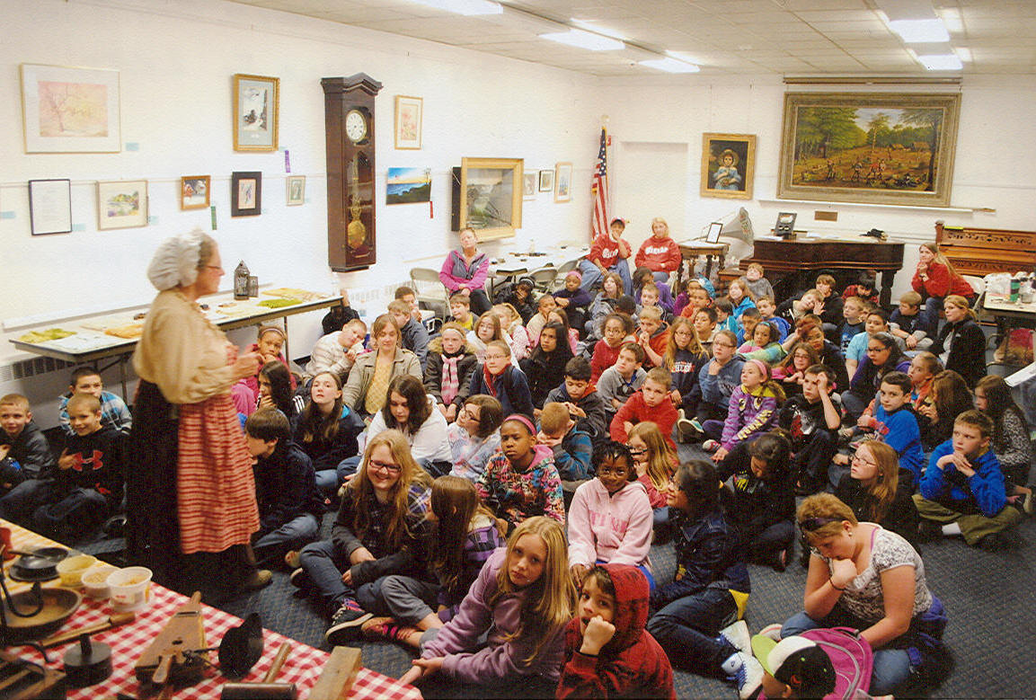
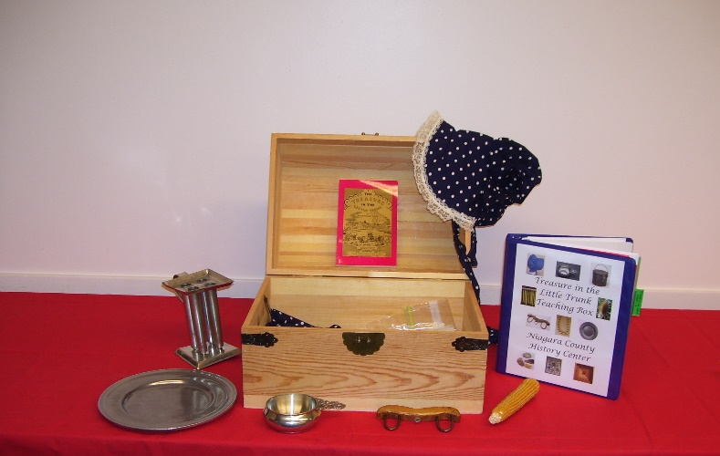
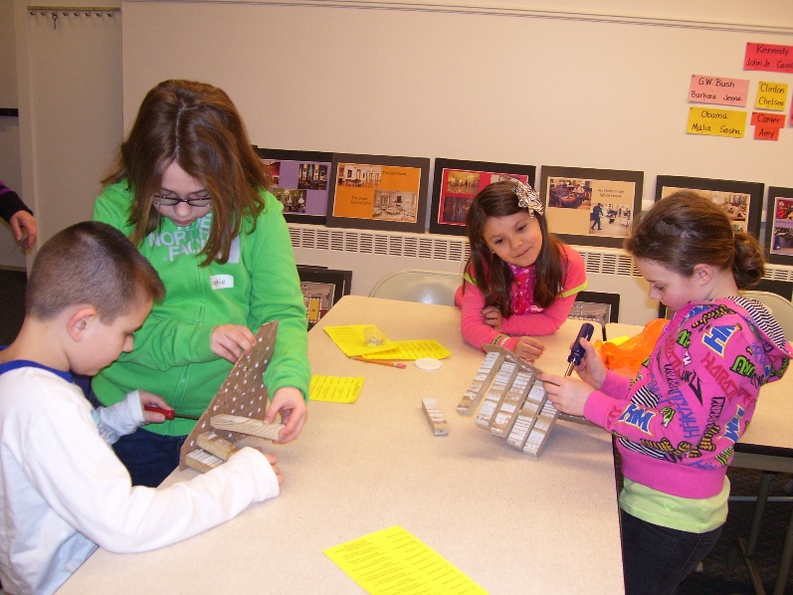
Educational Opportunities at the History Center of Niagara
School Tours
Special Request Historical On-Site and In-School Presentations
10 Teaching Boxes Available to Borrow for Your Class
Summer and School Holiday Programs

Slide 3
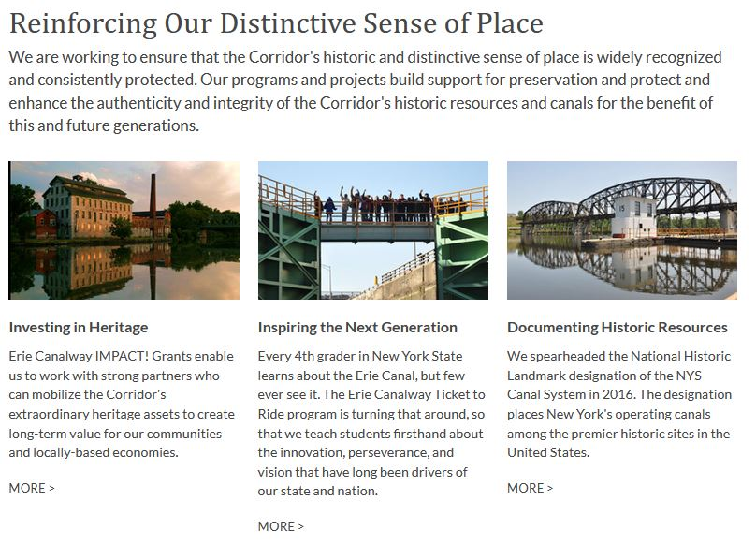
The History Center of Niagara wants to thank the Erie Canalway National Heritage Corridor for its continued support & sponsorship of our educational programs & outreach including “Ticket to Ride” & the new virtual lessons on the Erie Canal & the Flight of Five locks.

Slide 4
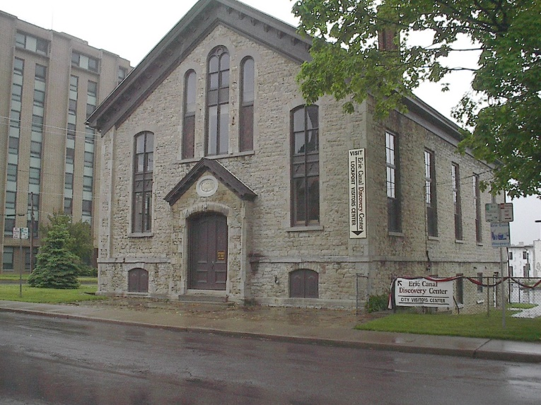
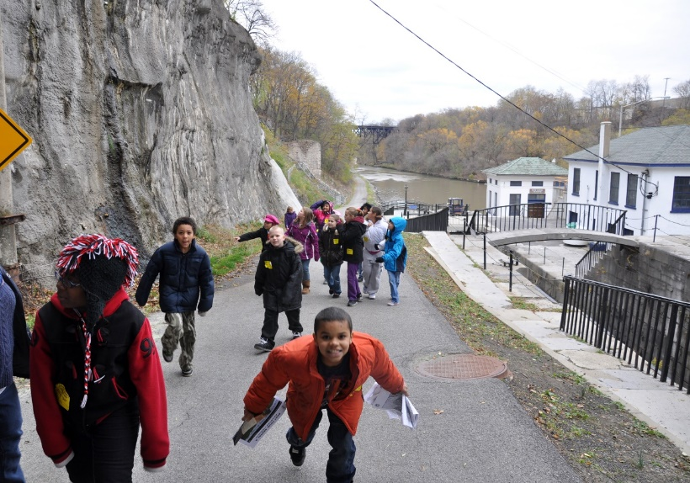
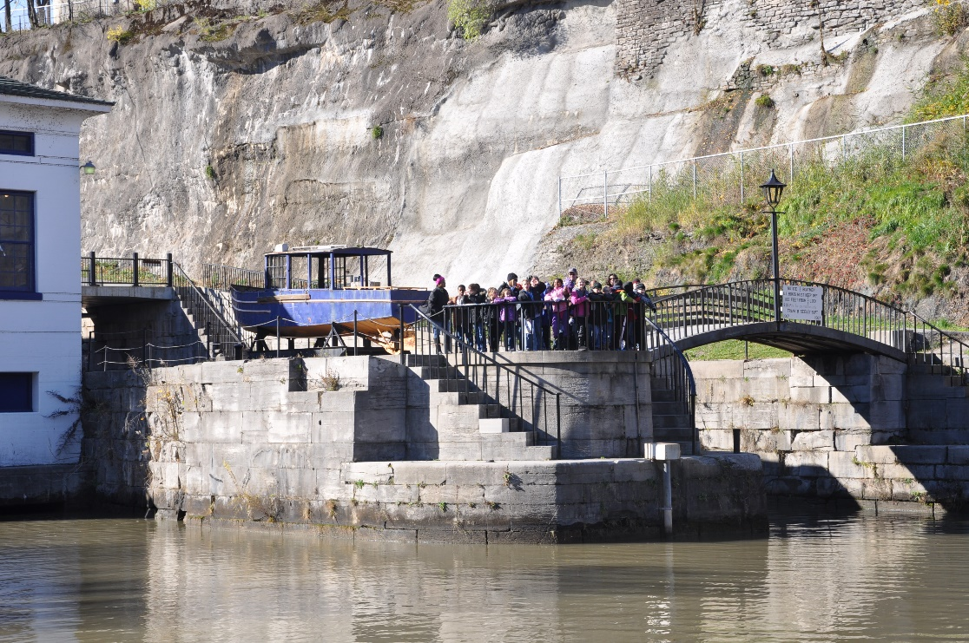
“Ticket to Ride” Program
Funded through the National Park Service and administered by the
Erie Canalway National Heritage Corridor. This covers bus costs and admission fees for school groups.
Indoor tour and activities at the Erie Canal Discovery Center in Lockport
Outdoor walking tour around the Flight of Five and the two 1918 Erie Barge Canal Locks

Slide 5
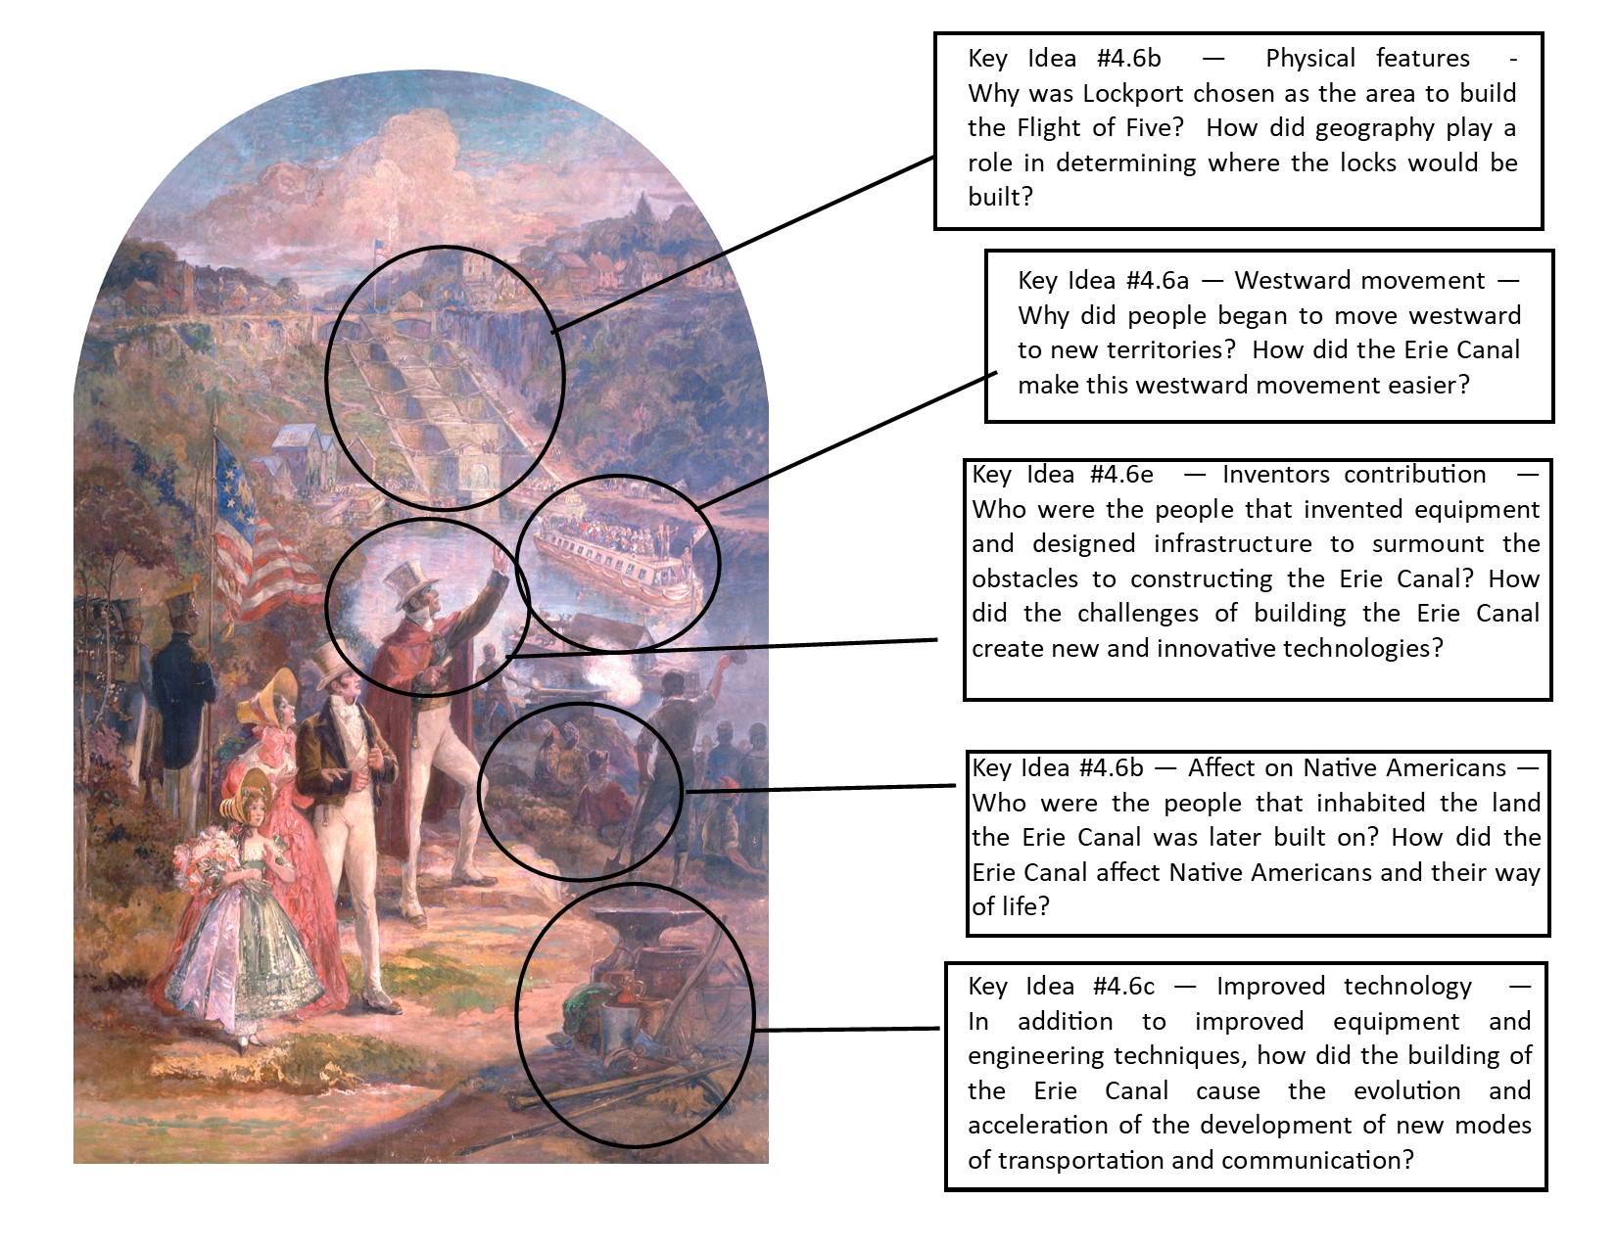
Erie Canalway National Heritage Corridor Impact! Grant
To create virtual lessons for
Grade 4 Unit 6:
Westward Movement and Industrialization ​Inquiry Design Lesson Plans and Presentations
using the Raphael Beck Mural
“The Opening of the Erie Canal,
October 26, 1825”
inside the Erie Canal Discovery Center

Slide 6
Educators Involved in Creating the Erie Canal Virtual Lessons
Heidi Ziemer, Outreach & Digital Services Coordinator
Western New York Library Resources Council
Rich Pyszczek, Jr., Coordinator for Social Studies
Buffalo Public Schools
Ann Marie Linnabery, Assistant Director & Education Coordinator
History Center of Niagara

Slide 7
Some Information About the Process
Started project in August 2020; completed and posted on the NFCSS in late March 2021
Committee met three times in person but worked mostly through email and phone conversations
Each of us had a slightly different vision of how the finished project would look but we were able to work together to coordinate our ideas to create the lessons which support the NYS Social Studies Standards for Grade 4, Unit 6
Video footage filmed over the last year to enhance the lessons will be uploaded by next spring. These segments will include short pieces delivered by actors, singers, educators and craftsmen, some in Erie Canal-era clothing, and will compliment material already in the lessons.

